Slide 1
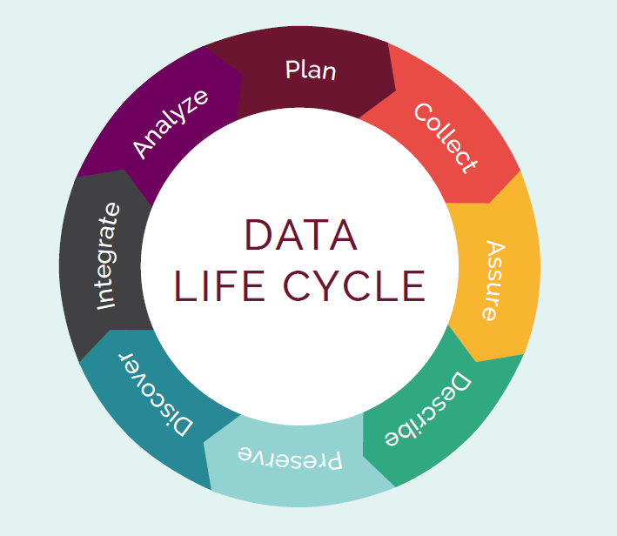
Data and Software
Preservation
From DataOne

Slide 2
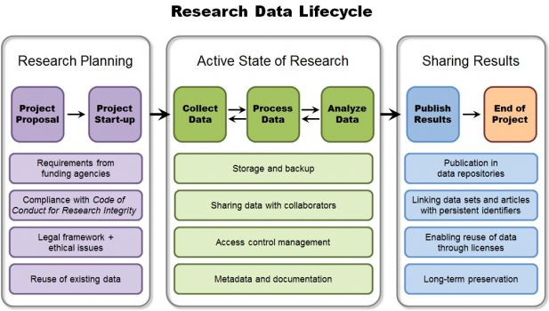
Research Data Lifecycle
From DTU AIS Bibliometrics and Data Management

Slide 3
What to consider
What types of data are being produced?
How, when, and who will do the work?
Who’s responsible for the data during the project and after?
What file naming system are you using?
Will the data be reviewed for quality?
Where will the data be stored?
Is the data properly described through metadata, a ReadMe file, and/or a codebook?

Slide 4
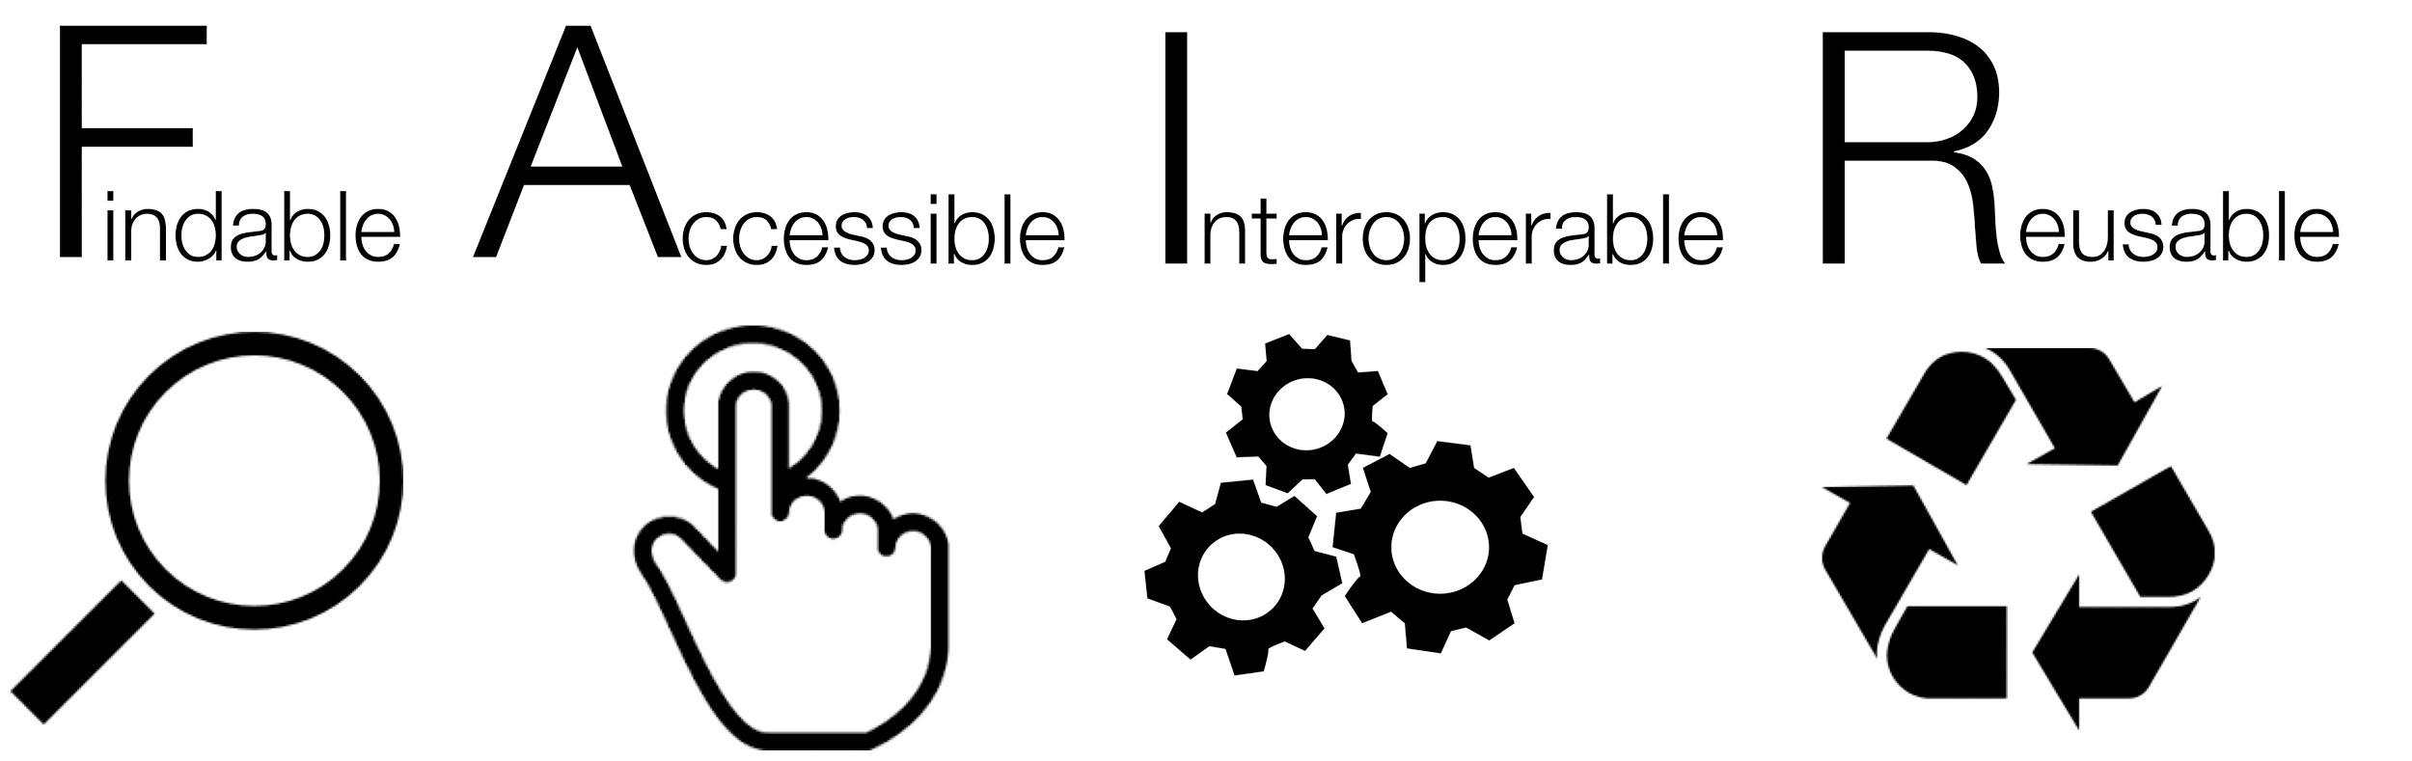
Sharing Data

Slide 5
FAIR Data
Findable
(Meta)data have a unique persistent identifier
Data have rich metadata
Metadata are in a searchable resource
Accessible
(Meta)data are retrievable by identifier using standardized communications protocol
Metadata accessible even when data isn’t

Slide 6
FAIR Data Pt. 2
Interoperable
(Meta)data use formal, accessible, shared, and broadly applicable language for knowledge representation
(Meta)data use vocabularies that follow FAIR principles
Reusable
Meta(data) are richly described with a plurality of accurate and relevant attributes
Clear and accessible data usage license; include detailed provenance; meet domain-relevant community standards

Slide 7
What to ask in picking a repository
What long-term preservation do they offer?
Will it provide enough for people to use your data?
What user support is available?
What are the funder/journal requirements?
Will the repository help show the impact of your work?
What are the terms and conditions?
What are the fees?

Slide 8
Where to share
UNR’s ScholarWorks
Zenodo
Dataverse
ICPSR

